Slide 1
IDE Integration

Slide 2
Outline
IDEs
Importing
POM viewer
Dependency Analyzer
Adding dependencies
Effective POM

Slide 3
.exe or .zip file
Java / Maven installation
Bundled Maven IntelliJ IDEA
https://www.jetbrains.com/idea/download/?section=windows
Installation

Slide 4
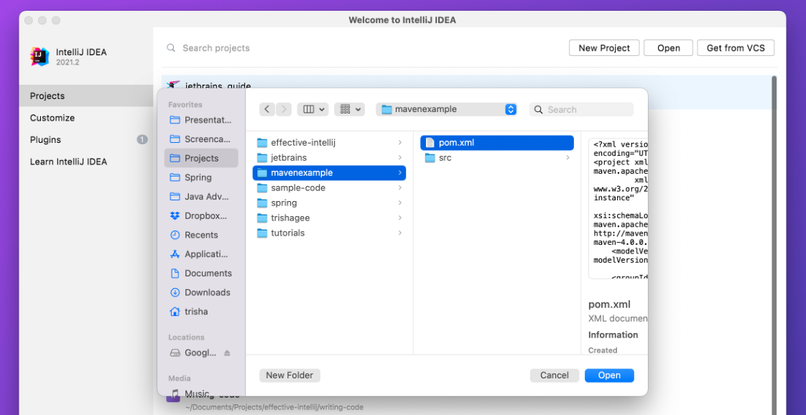
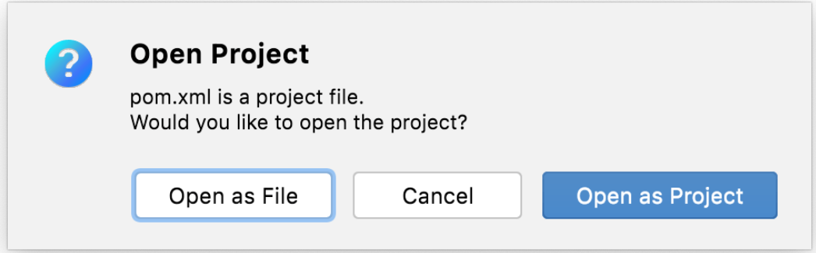
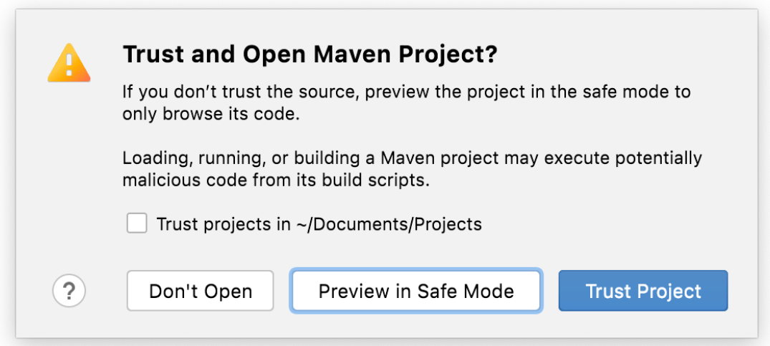
Importing

Slide 5
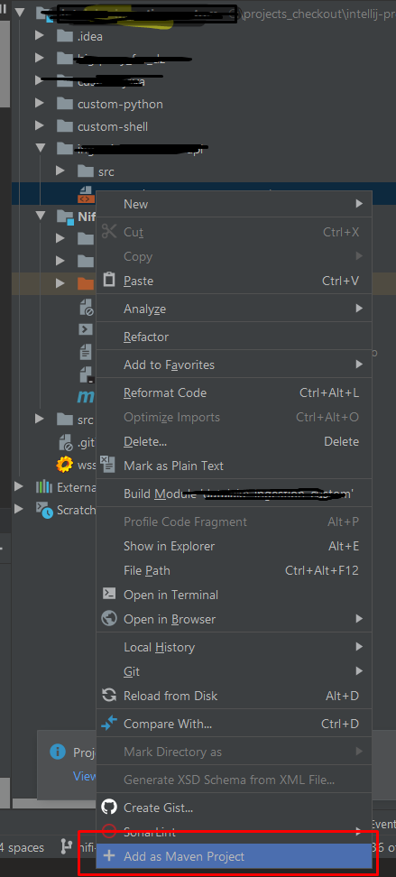
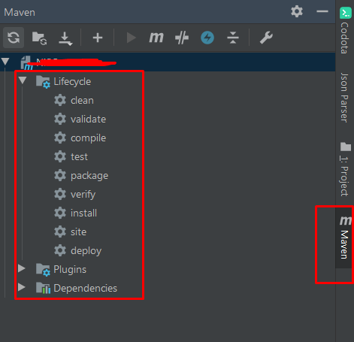
pom.xml
Add as Maven Project
Converting

Slide 6
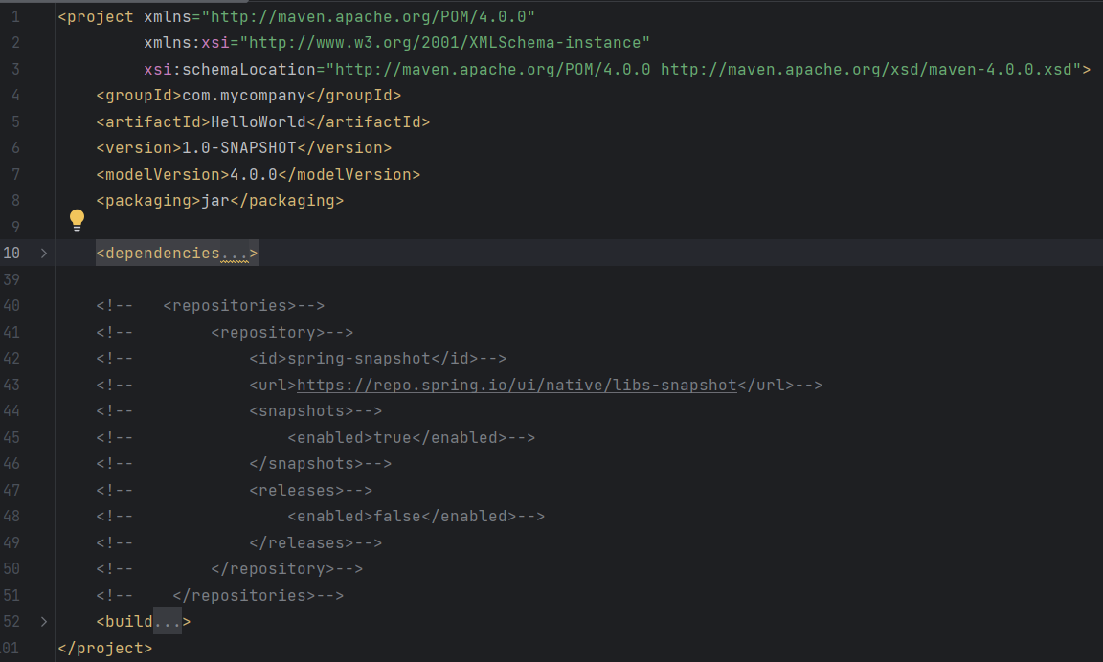
POM Viewer
Default View
High level elements
Expand and Contract

Slide 7
Manipulate dependencies
Dependency Management Add / Search screen
Add Dependencies

Slide 8
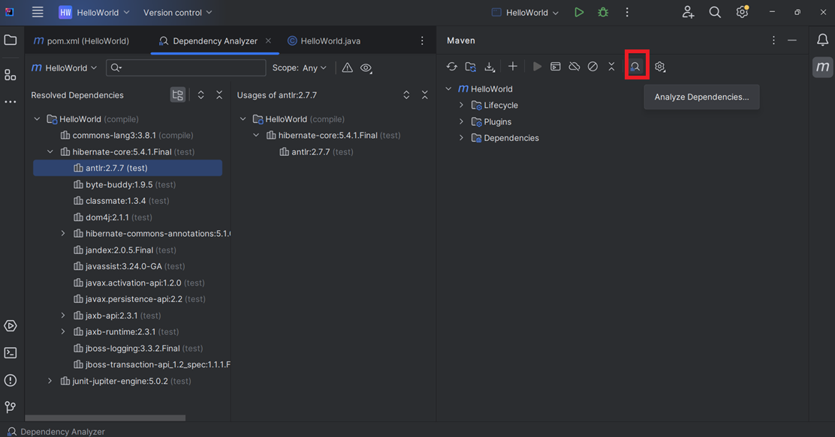
Dependency Analyzer
Displays dependency tree, including transitive and overridden
Scope also displayed

Slide 9
Effective POM
Complete POM, including inherited settings
Debugging tool
Default project source folders structure
Output directory
Plug-ins required
Repositories
Reporting directory which Maven will be using while executing the desired goals

Slide 10
Summary
IDE installation
Adding dependencies Dependency Resolution IDE configuration

